Slide 1

Factors associated with Anemia and Stunting for children under age 5 of Bangladesh: A study using BDHS 2010 data
Rezoanoor Rahman, Wenjing Liu & Yihao Zhao

Slide 2
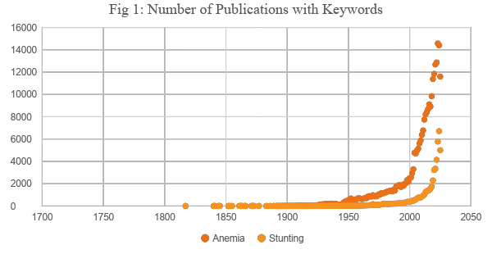
Introduction
Definitions (WHO)
Anemia(0/1): Haemoglobin concentration <110 g/L [1]
Stunting (0/1): if height-for-age is more than two standard deviations below the WHO Child Growth Standards median [2]
Anemia and stunting negatively affects cognitive development and learning ability.
Number of publications with keywords in 2024:
Anemia:14,404
Stunting: 6,707
Prediction models are useful for target interventions (e.g. nutrition programs, supplements) to the children most at risk.
Data Source: openalex.org

Slide 3
Data Information and Response Variables
Response Variables
Anemia (0/1)
Stunting (0/1)
Missing values
Label: ./999/9999
Less than 5% missing
Treatment: STATA default
Model Structure
Two separate multivariate logistic regression models
Data Information
Primary Source: 2010 Bangladesh demographic health survey (BDHS)
Subset criterion: High risk clusters
2283 children of age five years or below.
Cross-sectional data

Slide 4
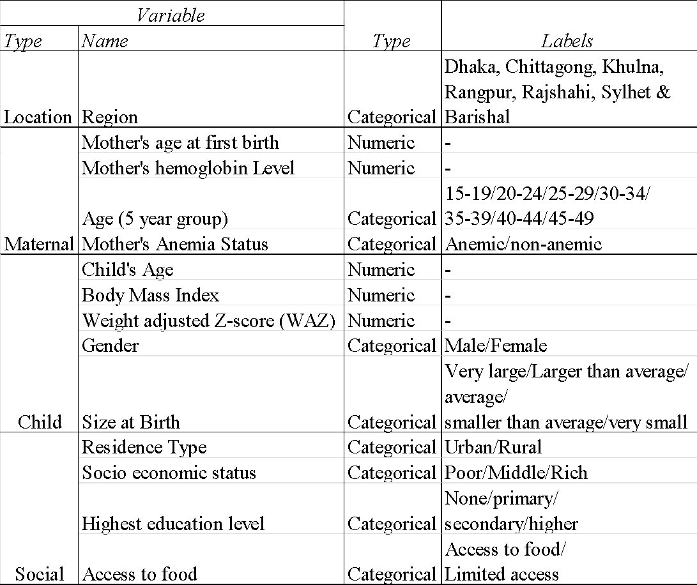
Independent Variables
Research Question 1: Which Maternal and Child factors are mostly associated with a child having Anemia/Stunting?
Vaivada et al. found that socioeconomic factors are stronger predictors for Stunting compared maternal characteristics [7].
Research Question 2: Does our data support this assertion for both Anemia and Stunting?

Slide 5
Methodology
Step 1: Initial Model Selection
Common/Naive strategy: Use all possible predictors.
D. W. Hosmer et al. (2000) [4] suggested the following steps to select the initial model.
Perform pairwise tests:
T-test for continuous predictors (with equal variance assumption)
Chi-square test of association for categorical predictors.
Select variables with p-value < 0.25
Limitation of using traditional cut-off values (e.g. p-values<0.05): often ignores important predictors.
Keep the selected variables which are scientifically important.

Slide 6
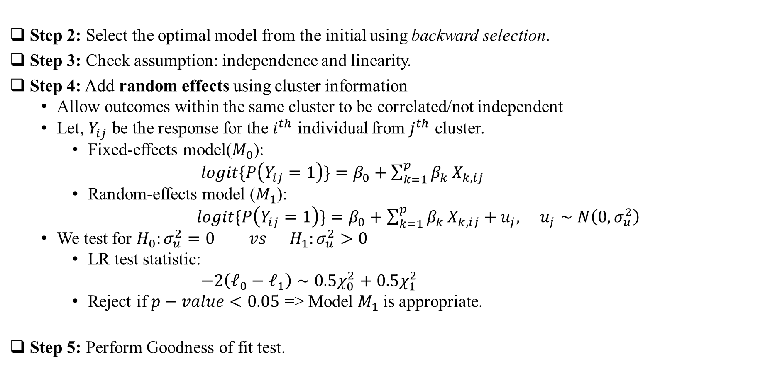
Methodology-con’t

Slide 7
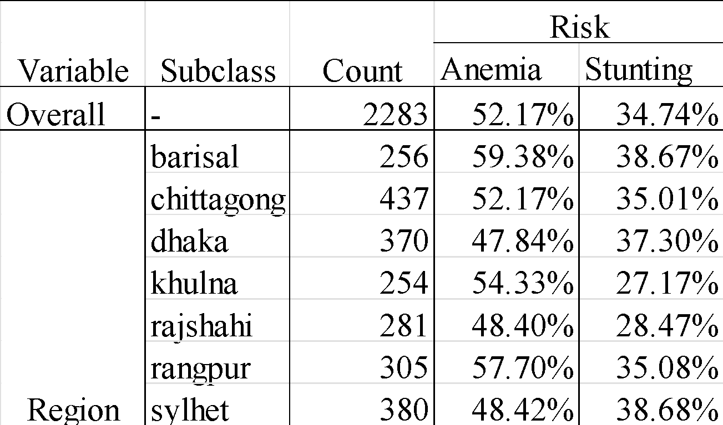
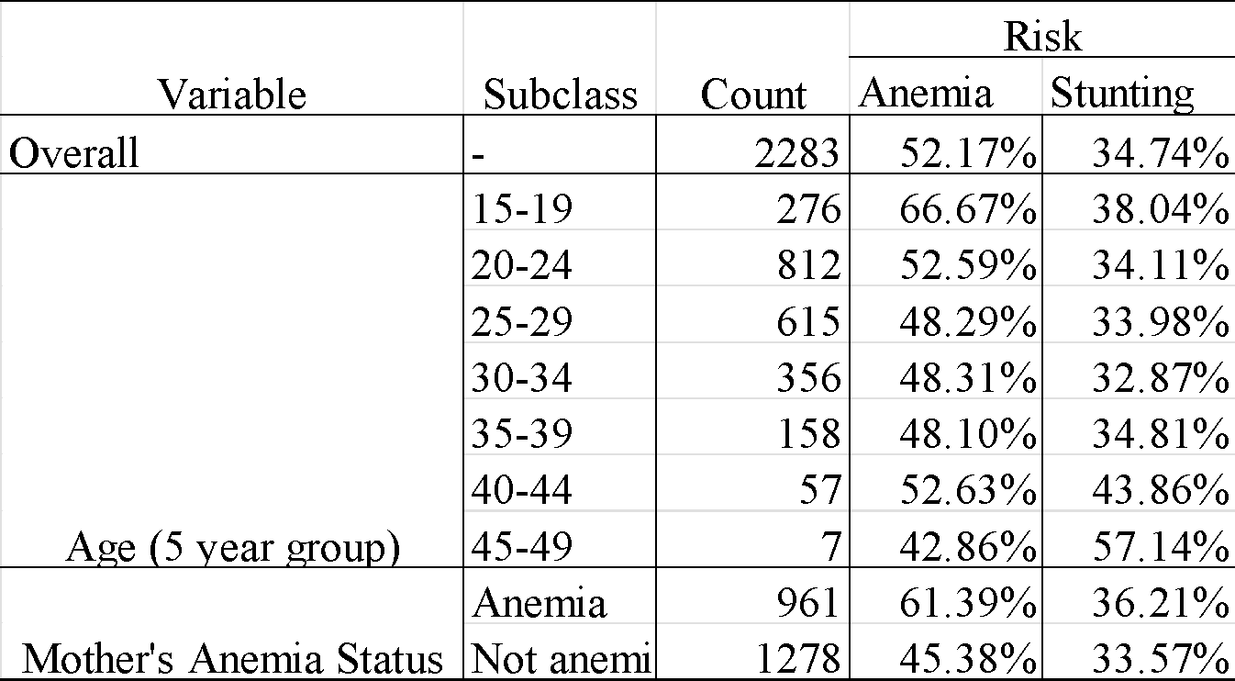
Results
Sub-category wise Risk
Variable Type: Location
Variable Type: Maternal factors

Slide 8
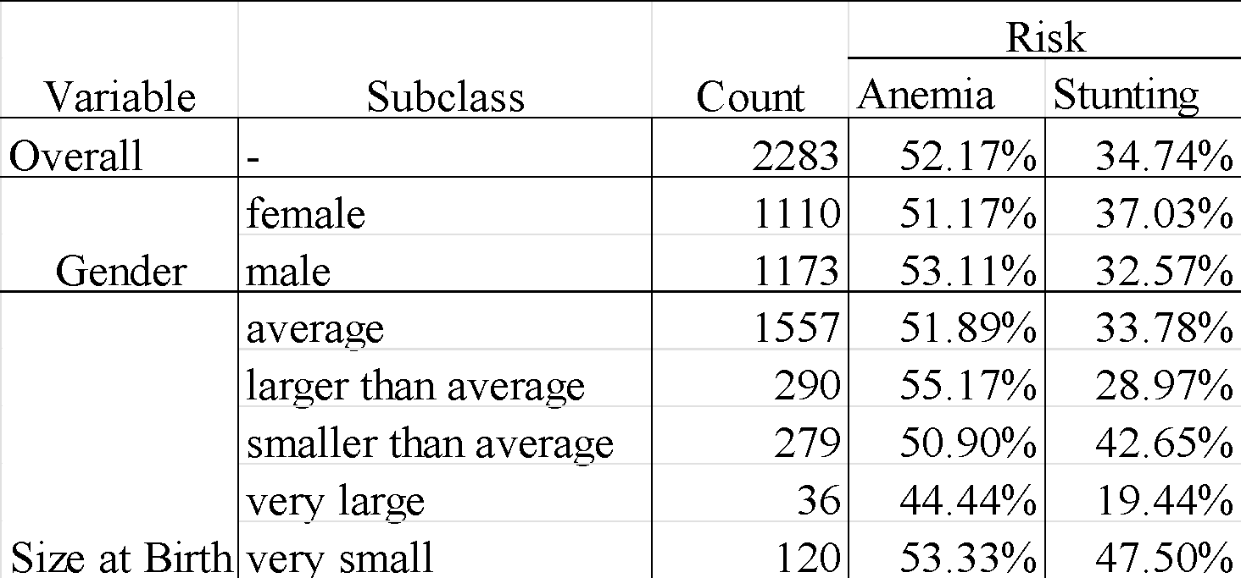
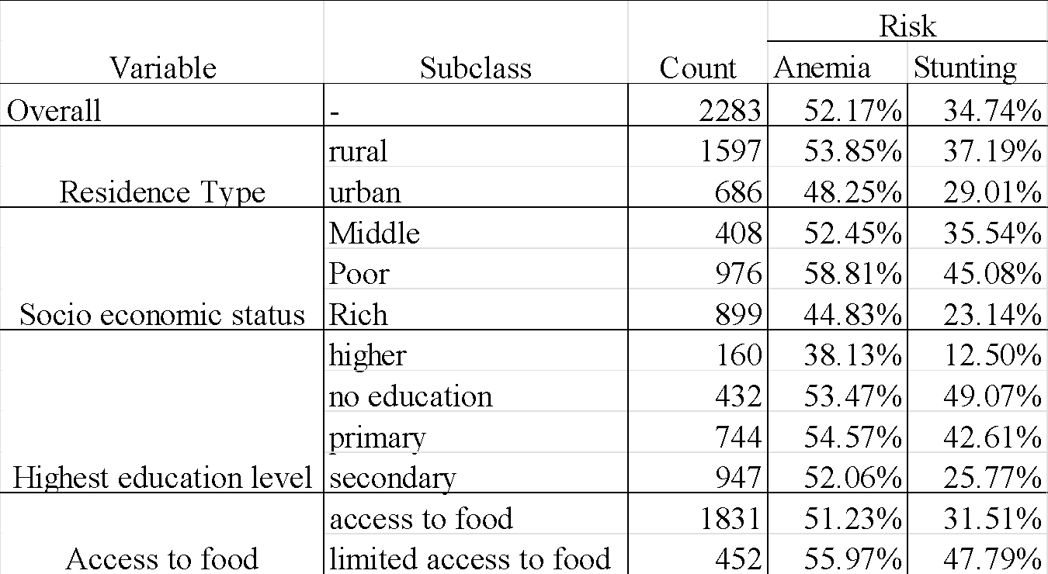
Sub-category wise Risk (Continued)
Variable Type: Child factors
Variable Type: Social

Slide 9
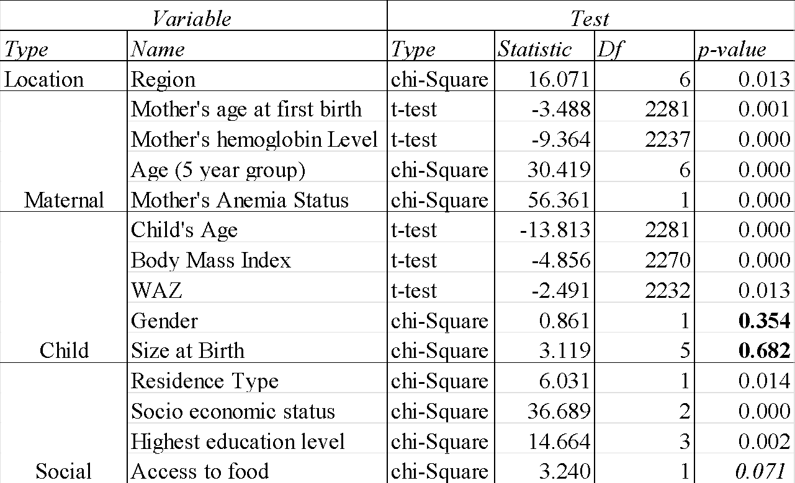
Initial Model Selection (Anemia)
Omit Variables:
Child’s gender
Child’s size at birth

Slide 10
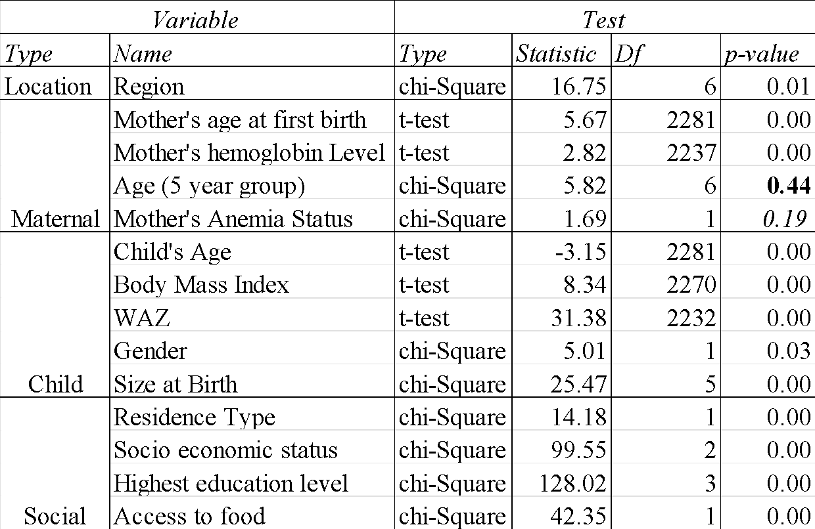
Initial Model Selection (Stunting)
Omit Variables:
Mother’s age

Slide 11
Backward Stepwise Variable Selection
Multivariable logistic regression models were fitted for anemia and stunting.
Backward elimination was applied to remove non-significant predictors.
Categorical predictors were evaluated using Wald joint tests (testparm).
Final models were retained based on statistical significance and theoretical relevance.

Slide 12
Anemia: Selection Steps
Step | Removed Variable | p-value
1 | mother’s anemia status | 0.892
2 | access to food | 0.708
3 | body mass index | 0.686
4 | residence’s type | 0.592
5 | age (5 year group) | 0.8962
6 | highest education level | 0.6964

Slide 13
Stunting: Selection Steps
Step | Removed Variable | p-value
1 | mother’s age at first birth | 0.991
2 | body mass index | 0.936
3 | residence type | 0.609
4 | Socioeconomic Status | 0.9345
5 | age (5 year group) | 0.3026
6 | region | 0.1038
7 | mother’s hemoglobin level | 0.214
8 | mother’s anemia status | 0.551
9 | child’s age | 0.135
10 | access | 0.063

Slide 14
Variable | Odds Ratio | p-value | 95%CI
Region (Barisal)
Chittagong | 0.73 | 0.083 | 0.52 – 1.04
Dhaka | 0.61 | 0.006 | 0.43 – 0.87
Khulna | 0.92 | 0.671 | 0.63 – 1.35
Rajshahi | 0.66 | 0.031 | 0.45 – 0.96
Rangpur | 0.9 | 0.572 | 0.62 – 1.30
Sylhet | 0.61 | 0.007 | 0.43 – 0.88
Socioeconomic Status(Poor)
Middle | 0.85 | 0.213 | 0.66 – 1.10
Rich | 0.71 | 0.002 | 0.58 – 0.88
Mother age at first birth (year) | 0.96 | 0.006 | 0.93 – 0.99
Mother hemoglobin (g/dL) | 0.97 | <0.001 | 0.97 – 0.98
Child age (month) | 0.96 | <0.001 | 0.96 – 0.97
WAZ (unit) | 0.999 | 0.012 | 0.998 – 1.000
Optimal Multivariable
Logistic Regression
(Anemia)

Slide 15
Variable | Odds Ratio | p-value | 95% CI
WAZ (per unit) | 0.98 | <0.001 | 0.98 – 0.98
Education Level (No Education)
Primary | 0.75 | 0.059 | 0.56– 1.01
Secondary | 0.54 | <0.001 | 0.40 – 0.73
Higher | 0.37 | 0.002 | 0.20 – 0.68
Optimal Multivariable
Logistic Regression
(Stunting)

Slide 16
Independence Assumption
Duplicates in terms of caseid
caseid represents mother
260 mothers has 2 children
3 mothers has 3 children
multiple children has the same mother
Independence assumption is violated
Copies | Observations | Surplus
1 | 1754 | 0
2 | 520 | 260
3 | 9 | 6
Note: Household number and cluster number also show many duplicates, confirming a multilevel structure (children nested within mothers, households, and clusters).

Slide 17
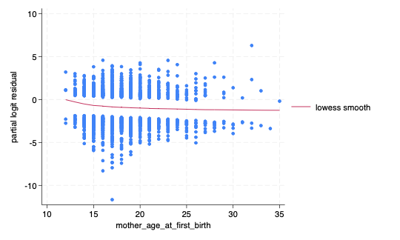
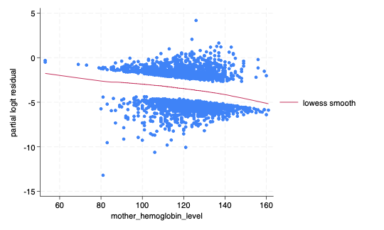
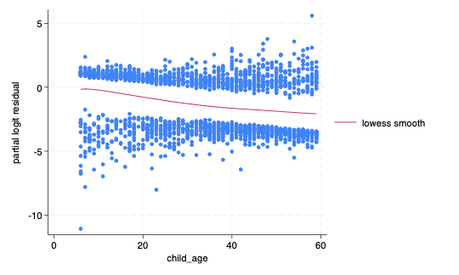
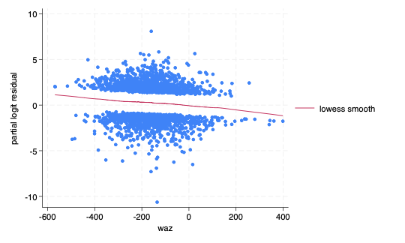
Linearity Assumption - Anemia
Linearity is satisfied for these 4 variables
Mother's age at first birth
Mother's hemoglobin level
Child's age
Weight adjusted Z-score that is a variable commonly used by WHO

Slide 18
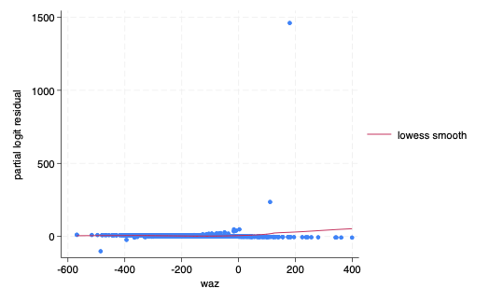
Linearity Assumption - Stunting
Linearity is satisfied, and the minor curvature comes from a few outliers.

Slide 19
Goodness-of-Fit (Hosmer-Lemeshow Test)
At 0.10 cutoff, both models show a reasonable fit to the data
Model | Test Statistic | p-value
Anemia | 5.76 | 0.67
Stunting | 12.97 | 0.11

Slide 20
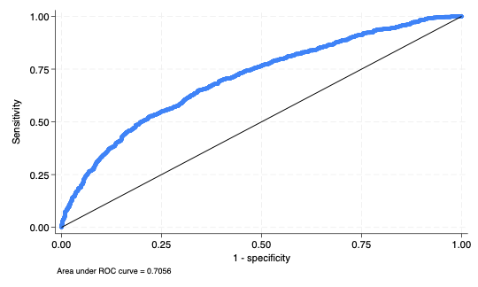
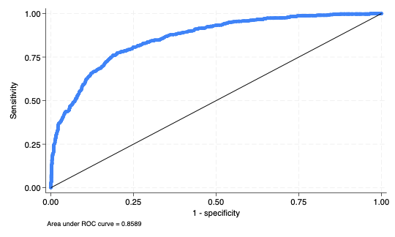
Prediction Accuracy
ROC-Anemia
ROC-Anemia
AUC = 0.71, indicating good discrimination
AUC = 0.86, indicating excellent discrimination

Slide 21
Variable | Odds Ratio | p-value | 95% CI
Region (Barisal)
Chittagong | 0.72 | 0.080 | 0.5 – 1.04
Dhaka | 0.60 | 0.007 | 0.41 – 0.87
Khulna | 0.91 | 0.635 | 0.61 – 1.35
Rajshahi | 0.65 | 0.032 | 0.44 – 0.96
Rangpur | 0.89 | 0.554 | 0.60 – 1.31
Sylhet | 0.61 | 0.009 | 0.42 – 0.89
Socioeconomic Status (Poor)
Middle | 0.84 | 0.199 | 0.65 – 1.094
Rich | 0.71 | 0.002 | 0.57 – 0.89
Mother age at first birth (year) | 0.96 | 0.006 | 0.93 – 0.99
Mother hemoglobin (g/dL) | 0.97 | <0.001 | 0.97 – 0.98
Child age (months) | 0.96 | <0.001 | 0.96 – 0.97
WAZ | 0.99 | 0.013 | 0.998 – 1.0
Mixed-effect Logistic Regression - Anemia
Accounting for lack of independence [5]
Results are very similar to the logistic model
Cluster-level variance (0.08) is small → little added variability
LR test (p-value = 0.17) is not significant → random effects not statistically required
But data are not independent, so a mixed-effects model remains the appropriate choice

Slide 22
Mixed-effect Logistic Regression (Stunting)
Accounting for lack of independence [5]
Results are very similar to the Multivariable logistic model
Cluster-level variance (0.14) is small → little added variability
LR test is significant (p-value = 0.02)→ random effects statistically improved the model
Mix-effect logistics is the preferred model for Stunting
Variable | Odds Ratio | p-value | 95% CI
WAZ | 0.98 | <0.001 | 0.981 – 0.984
Education Level (No Education)
Primary | 0.75 | 0.065 | 0.546 – 1.018
Secondary | 0.55 | <0.001 | 0.402 – 0.752
Higher | 0.36 | 0.002 | 0.188 – 0.682

Slide 23
Discussion
Purpose of Study:
Using BDHS data, determine which maternal, child, and social factors are most associated with childhood anemia and stunting and whether socioeconomic factors are stronger predictors, as suggested by Vaivada et al.
Major Analytical Findings:
Anemia: Higher maternal hemoglobin, older maternal age at first birth, older child age, higher WAZ, and being from Dhaka or Sylhet, plus higher socioeconomic status, were all associated to lower odds of anemia.
Stunting: Higher WAZ and higher maternal education levels were strongly associated with lower odds of childhood stunting.
Public Health Implications:
Improving maternal nutrition, Strengthen women’s education, may reduce anemia risk in children
Region disparities suggest a need for target interventions in high-risk areas
Strengths:
Strict variable selection and full assumption checking
Used mixed-effect model to correctly account for multilevel data
High predictive performance, anemia-AUC = 0.71, & stunting-AUC = 0.86

Slide 24
Limitations & Future Directions
Limitations:
Unmeasured confounders (e.g. diet, infection history) not available
Cross-sectional data, no causal conclusions (i.e. can identify association but not determine the cause of the disease)
Self-reported socioeconomic and maternal variables may contain reporting bias
Multilevel clustering may be more complex than the model structure allows
Regional disparities were identified but not deeply explored due to data limits
Future Directions:
Develop prediction tool for field workers to identify at-risk children
Incorporate additional biological, dietary, and environmental variables
Use complex model structures to capture nonlinear predictors and interactions
Stunting and anemia often co-occur [6]. Perhaps a bivariate logit/probit model would be more appropriate.

Slide 25
References
[1] World Health Organization. (2011). Haemoglobin concentrations for the diagnosis of anaemia and assessment of severity url: https://iris.who.int/server/api/core/bitstreams/b82789de-df63-41ba-8058-25f9f5da0c40/content
[2] World Health Organization. (2015, November 19). Stunting in a nutshell. url: https://www.who.int/news/item/19-11-2015-stunting-in-a-nutshell
[3] Bursac, Z., Gauss, C. H., Williams, D. K., & Hosmer, D. W. Purposeful selection of variables in logistic regression. Source Code for Biology and Medicine (2008) 3:17
[4] Hosmer, D. W., Lemeshow, S., & Sturdivant, R. X. Model-Building Strategies and Methods for Logistic Regression. In: Applied Logistic Regression, Chapter 4, Wiley (2000), pp. 91–142.
[5] Hosmer, D. W., Lemeshow, S., & Sturdivant, R. X. Model-Building Strategies and Methods for Logistic Regression. In: Applied Logistic Regression, Chapter 9.2 - 9.5, Wiley (2000)
[6] Gosdin L, Martorell R, Bartolini RM, Mehta R, Srikantiah S, Young MF. The co-occurrence of anaemia and stunting in young children. Matern Child Nutr. 2018 Jul;14(3):e12597. doi: 10.1111/mcn.12597.
[7] Vaivada T, Akseer N, Akseer S, Somaskandan A, Stefopulos M, Bhutta ZA. Stunting in childhood: an overview of global burden, trends, determinants, and drivers of decline. Am J Clin Nutr. 2020;112(Suppl 2):777S–791S. doi: https://doi.org/10.1093/ajcn/nqaa159.

Slide 26
Questions?
“Until next time, stay significant”

